Slide 1
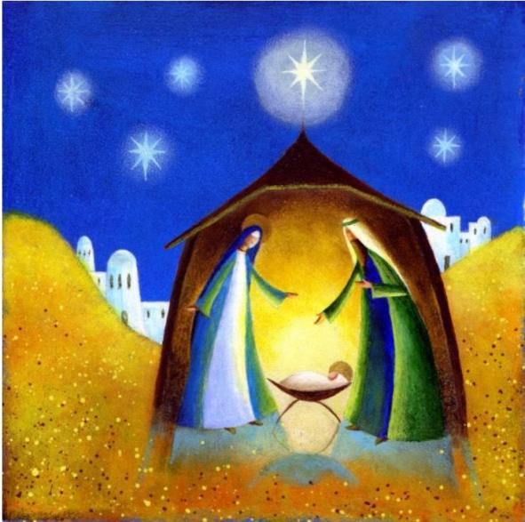
The Advent Windows 2020
A message for Willingham

Slide 2
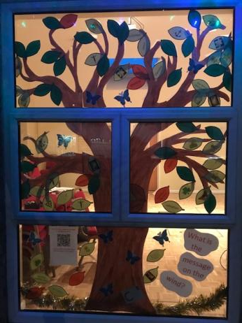
A message of hope

Slide 3
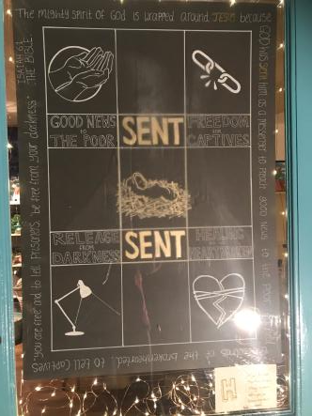
A message from Isaiah

Slide 4
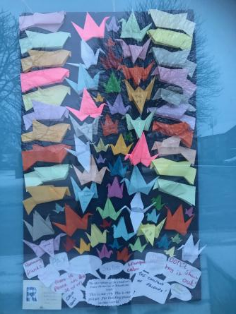
A message of peace

Slide 5
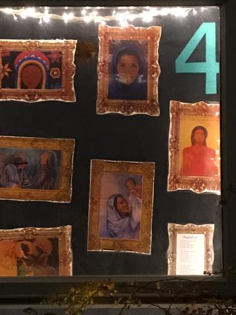
A message from Mary

Slide 6
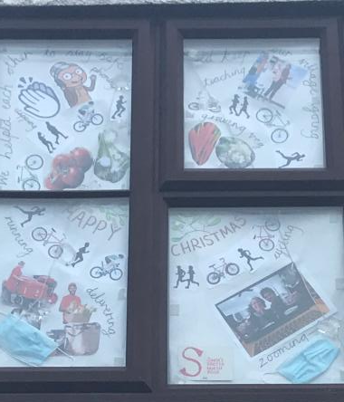
A message of community

Slide 7
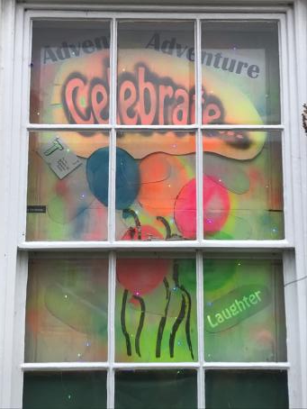
A message of celebration

Slide 8
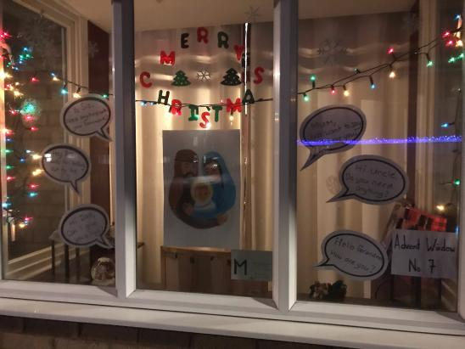
A message from Joseph

Slide 9
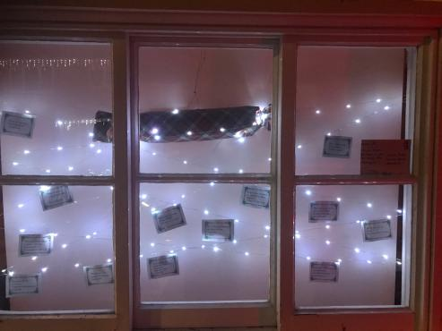
A message of laughter

Slide 10
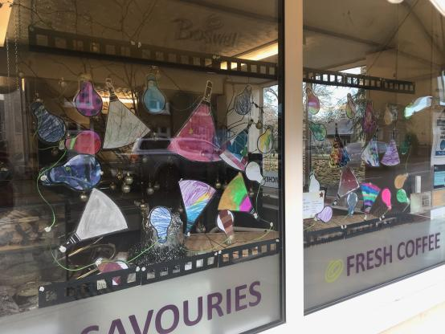
A message of light

Slide 11
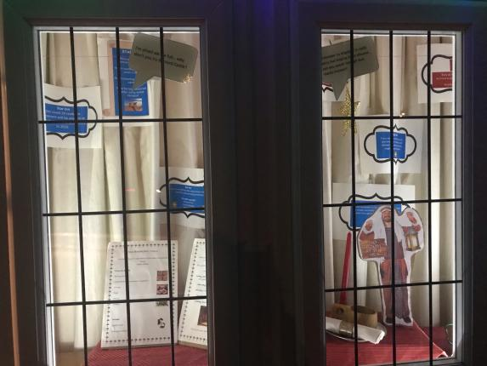
A message from the innkeeper

Slide 12
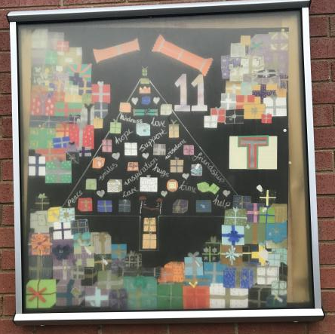
A message of giving

Slide 13
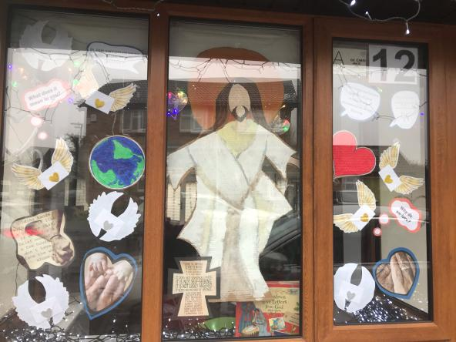
A message of love

Slide 14
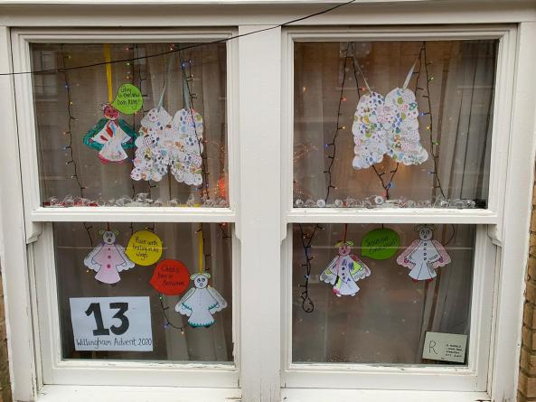
A message from the angels

Slide 15
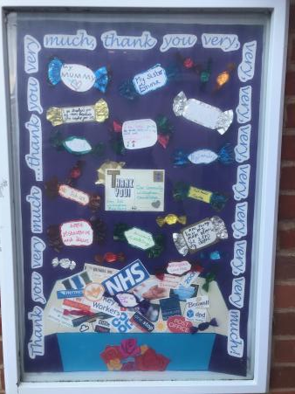
A message of thankfulness

Slide 16
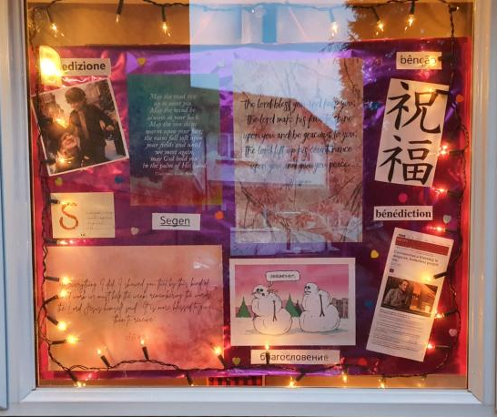
A message of blessing

Slide 17
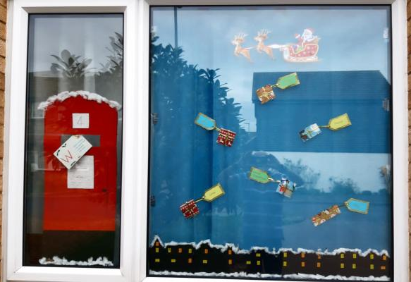
A message from Santa

Slide 18
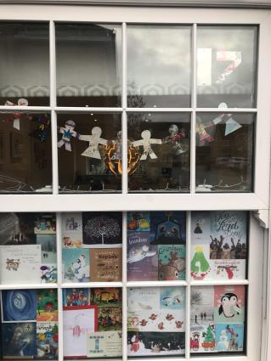
A message of family and friendship

Slide 19
A message from the shepherds

Slide 20
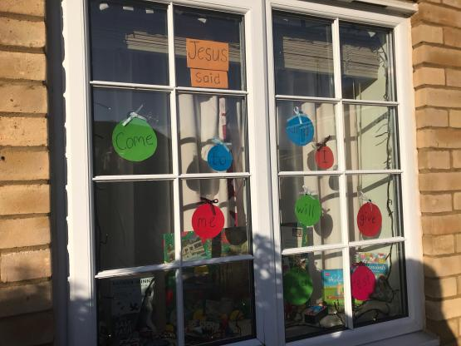
A message of rest and relaxation

Slide 21
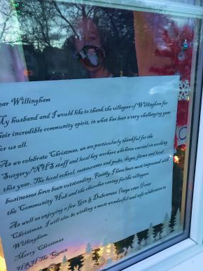
A message from the Queen

Slide 22
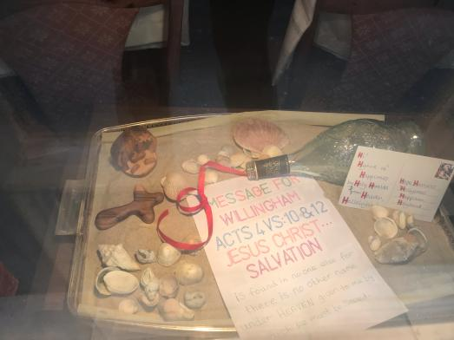
A message of salvation

Slide 23
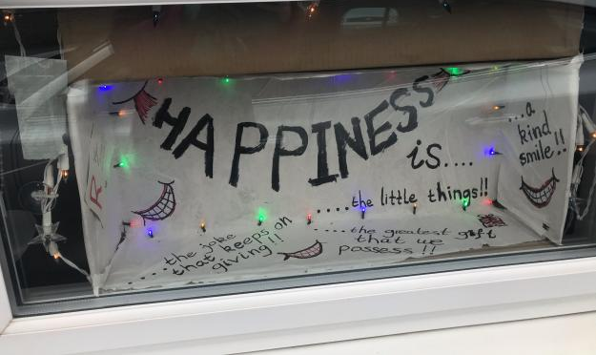
A message of happiness

Slide 24
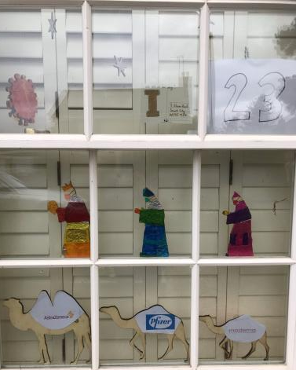
A message from the wise men

Slide 25
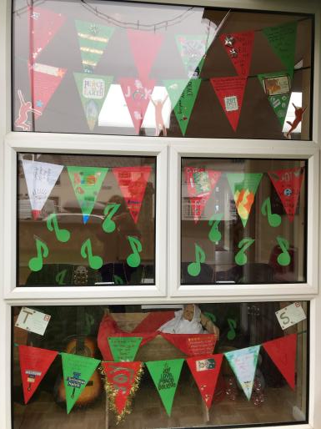
A message of joy

Slide 26
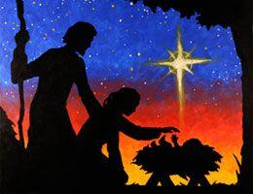
And the letters spell out…. Christmas starts with Christ

Slide 27
Thankyou to everyone who created windows this year! We couldn’t do it without you!!

Slide 28
And what will be the theme next year…

